Slide 1
#DHHFosteringJoy: A Movement to Celebrate the Magic of Raising Children who are D/HH
Notes:
Note from Fostering Joy Core Team:
We are so grateful you wish to share Fostering Joy with others! You are an integral part of the “Fostering Joy Movement.”
We do ask that you not alter the content of the slides in this deck. Do feel free to add additional slides. And if you’re not able to use all the slides, please pick the slides most relevant to your presentation.
Thank you again for spreading joy to parents of children who are deaf and hard of hearing.
-Fostering Joy Core Team

Slide 2
The Joy Core Team
Amy Szarkowski, Psychologist, LEND, Boston Children's Hospital, Beverly School for the Deaf
Candace Lindow-Davies, Director of Outreach, Hands & Voices HQ
Jennifer Clark, Early Intervention Deaf and Hard-of-Hearing Specialist Hawaii Department of Health Early Intervention
Janet DesGeorges, Executive Director, Hands & Voices HQ
Marilyn Sass-Lehrer, Professor Emerita, Gallaudet University
Sara Honigfeld, Parent Infant Program Director, The Learning Center for the Deaf
Nicole Hutchinson, Parent-Infant Program Coordinator, The River School, Washington DC
Past Member: Linda Lytle, Professor, Department of Counseling, Gallaudet University
Notes:
Parents of children who are D/HH and professionals with experience working closely with parents came together. Not to ignore or make light of the experience of adjusting to the identification of a child being deaf or hard of hearing, but rather to acknowledge that with sensitivity and also help guide parents to seeing the innate strengths of their child and guiding parents to intentional take time to celebrate the joy the child brings. Understandably, the needs of the child are to be addressed. Also, wish to support the strengths that the parent has in loving and bonding with their child through play and activities.

Slide 3
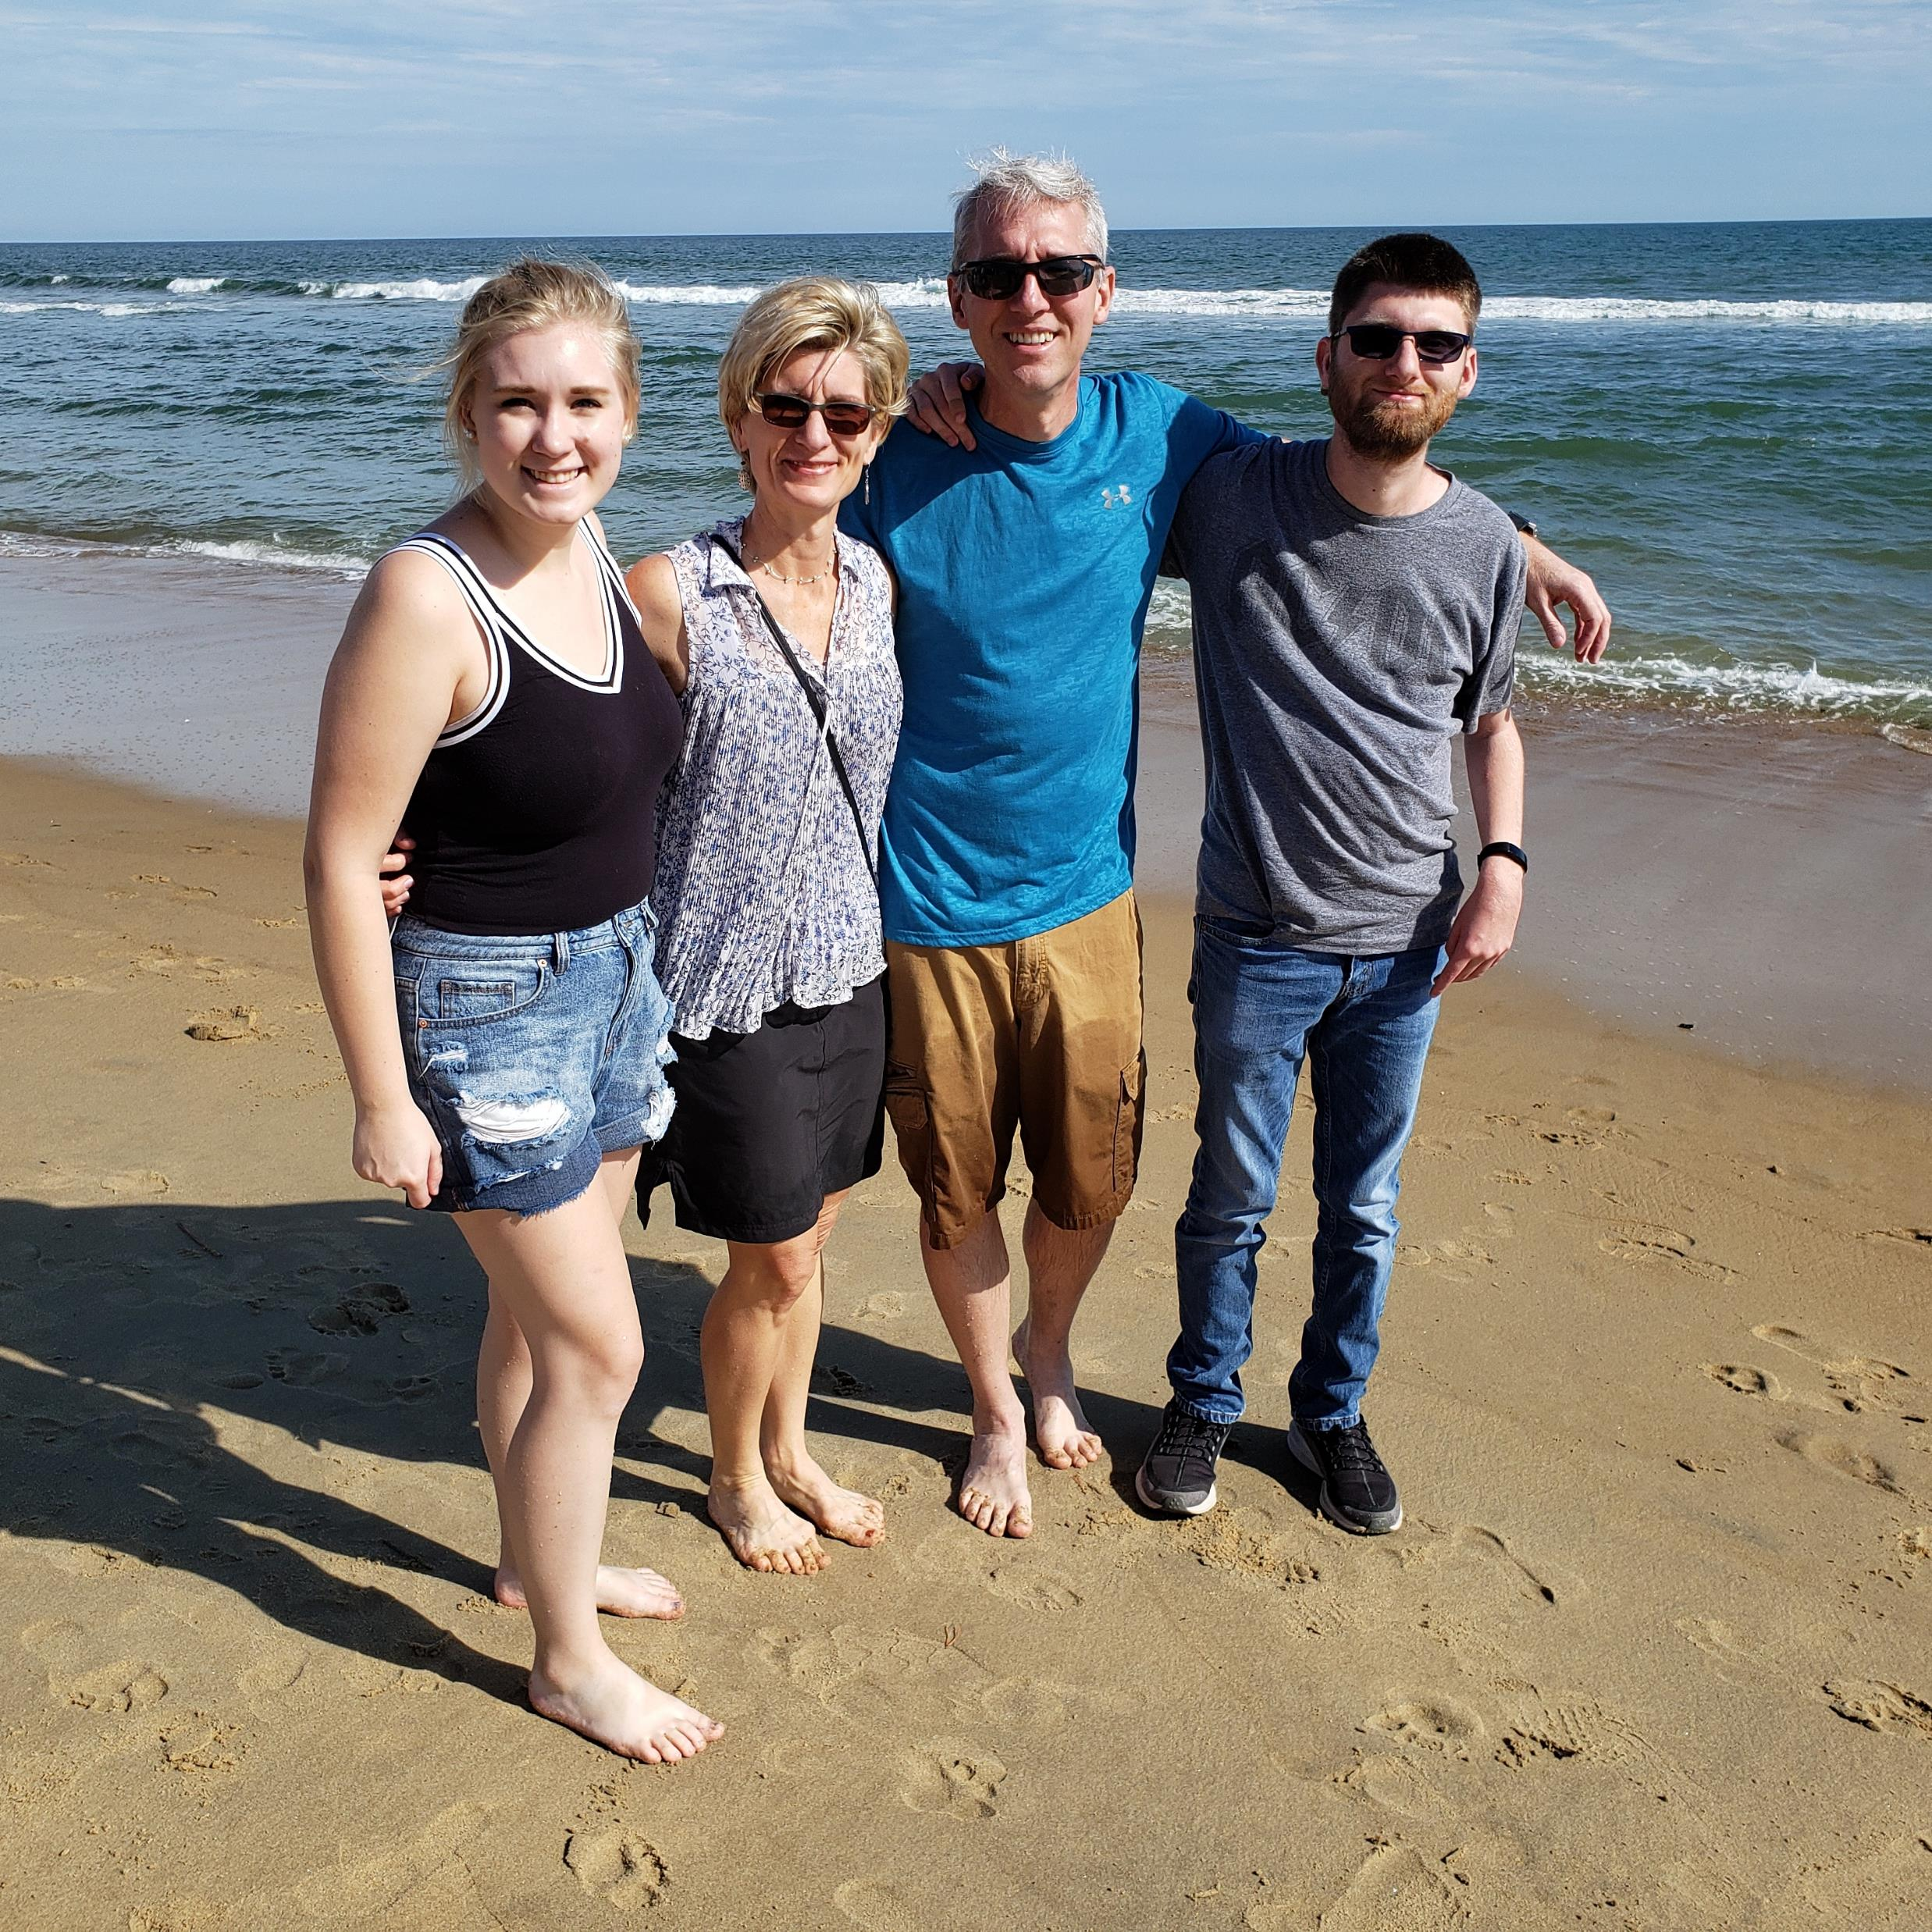
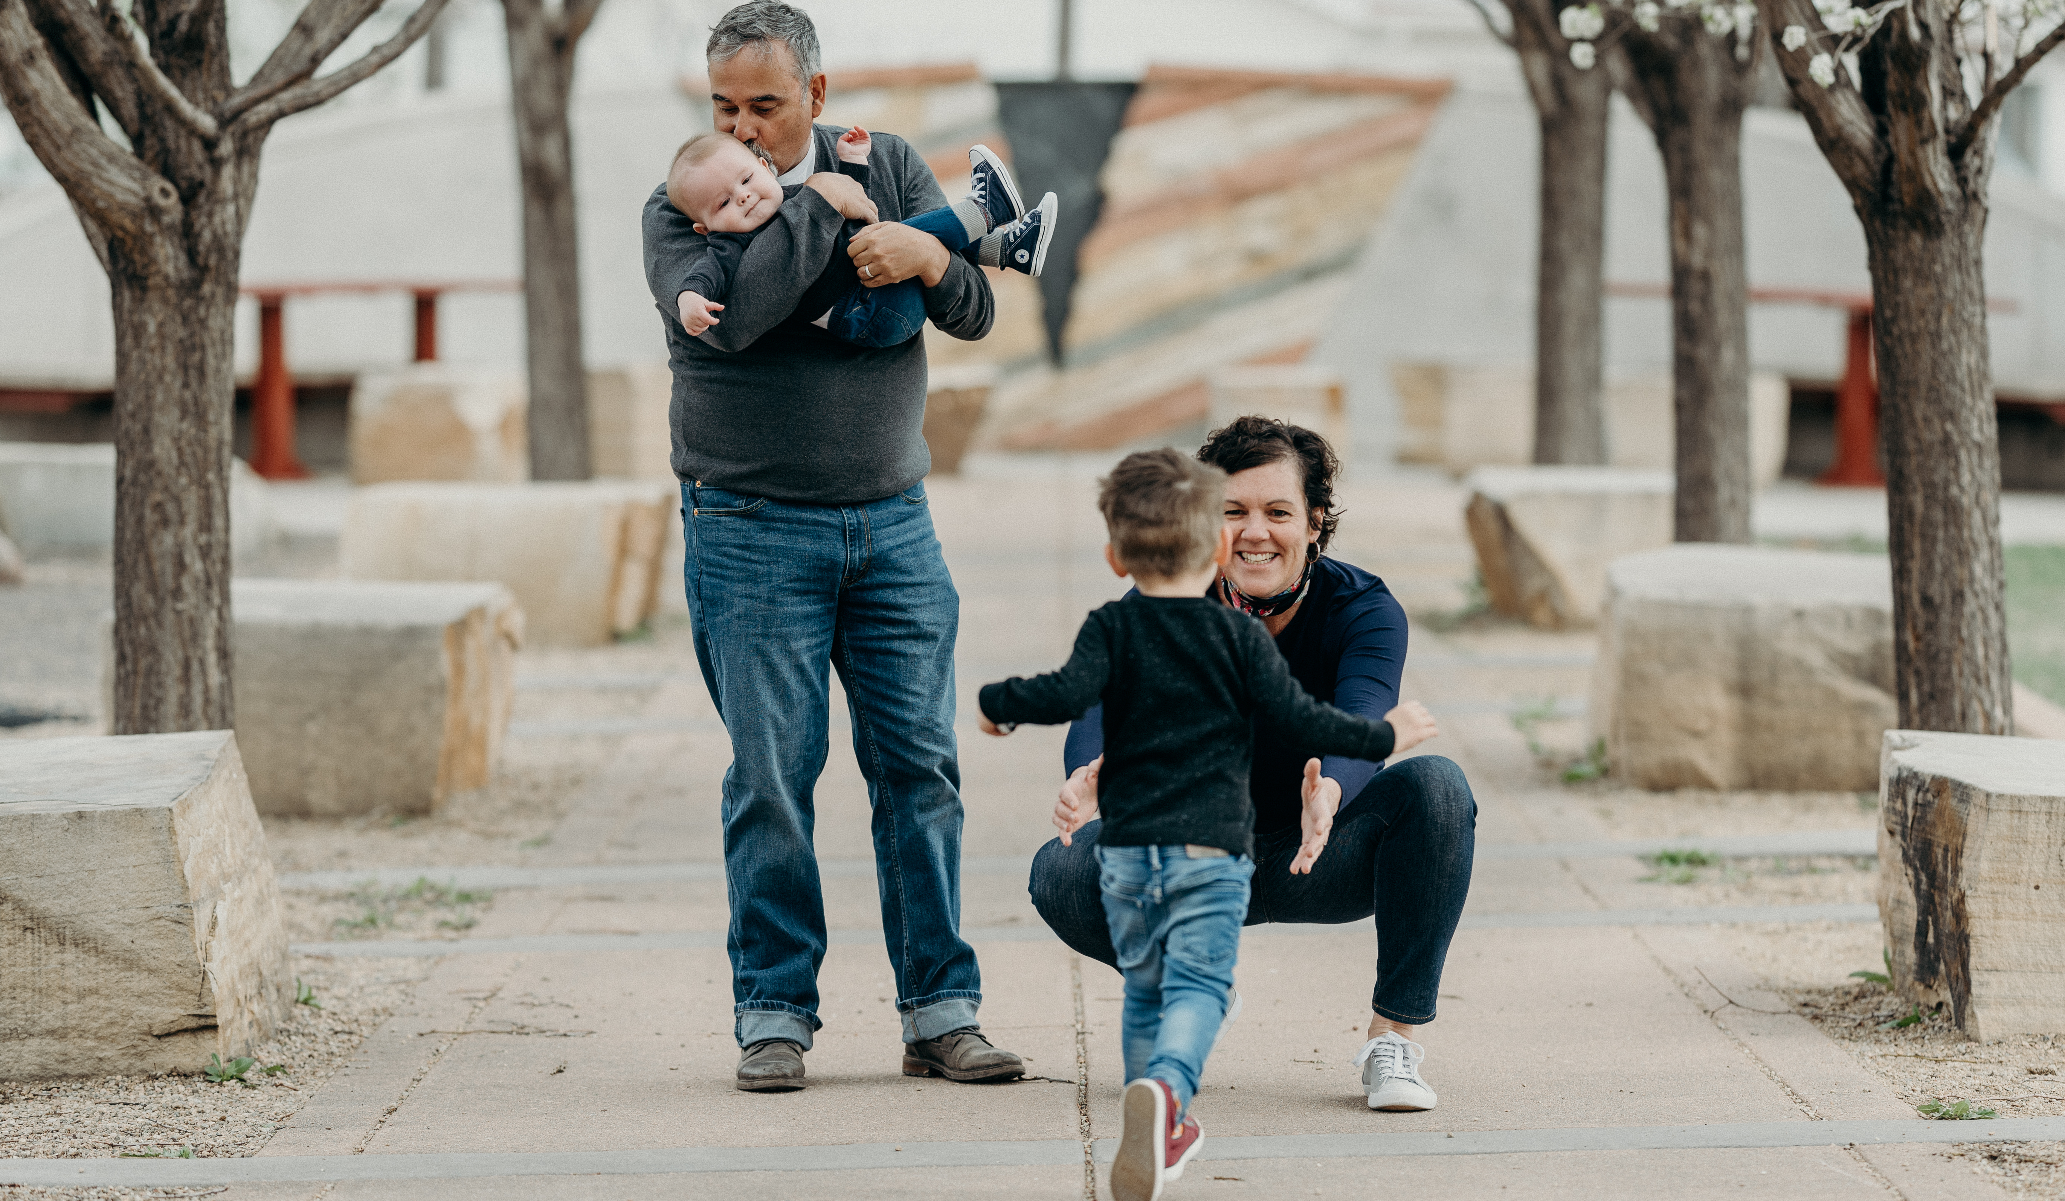
Why We Came Together
Notes:
Left: Candace Lindow-Davies, husband and 2 children Right: Janet DesGeorges, husband and grand children
Insert an additional slide for Why You are a Joy Ambassador.

Slide 4
We Want to Change the Conversation from Challenges and Mitigation to…
Notes:
Presenter: You may wish to add your own comments of connection to Fostering Joy. If a parent, insert personal story of how this work resonates with you. If a professional, add experiences supporting families and how this work resonates in your work.

Slide 5
…attending to Social-Emotional Functioning
…not just language
…not just audiologic concerns
…not just medical questions
But really Fostering Joy

Slide 6
What Do We Know?
Parents who report experiencing high levels of stress tend to have deaf or hard of hearing children who have greater levels of emotional difficulties and reduced socioemotional development (Hintermair, 2006).
Among families with deaf or hard of hearing children, taking care of the special needs of family members and having insufficient relief from stress were rated as having the greatest negative impact on Family Quality of Life (Jackson, Wegner & Turnbull, 2010)

Slide 7
What Else Do We Know?
An overview of emotional availability of caregivers toward infants and toddlers has shown that the extent to which caregivers can attend, attune, and foster engagement with their infants and toddlers will influence the child’s social and emotional development (Bornstein, Suwalsky & Breakstone, 2012)
Positive mother-child interactions are reinforced by social networks of families with children who are deaf or hard of hearing (Meadow-Orlans, Mertens & Sass-Lehrer, 2003)
Parent attitudes, parent involvement, social support, expectations, and problem-solving skills are related to academic and social development of children who are deaf (Calderon & Greenberg, 2011).

Slide 8
Fostering Joy
A Sentiment
A Call to Action
A Movement
Notes:
The evolution of Fostering Joy from just an idea to the need to do something to the invitation to others which seemed to strike a chord with parents and professionals as a gap/a need to help parents find and celebrate the joy of their child who is DHH.

Slide 9
Mission Statement
“Fostering Joy is a family/professional effort celebrating the joy of raising a child who is deaf or hard of hearing (D/HH).
Fostering Joy provides resources for families and professionals to support the growth and development of a child who is D/HH.
Loving and supportive families provide a strong base for social and emotional health and well-being.
Focusing on special moments that bring joy helps families put aside concerns and focus on their natural and loving parent-child connections.”

Slide 10
Past Activities
2018: Parent Focus Group at Hands & Voices Annual Leadership Conference
2018 to Present: Adaptation of SEAM Assessment tool
2019: Presentations at EHDI Annual Meeting and 2019 Hands & Voices Leadership Conference
Summer 2019: Formation of Parent/Professional Advisory Group
Nov 2019: Creation of a #DHHFosteringJoy closed Facebook group for parents, Twitter and Instagram Accounts for all
Spring 2020: Development of a PowerPoint Template and Parent Tip Sheets
March 2019: Presentation at EHDI Annual Meeting
March 2020: Presentation at EHDI Annual Meeting
Notes:
The Fostering Joy Core Team has worked with the Author and Publishers of the SEAM Tool: https://brookespublishing.com/product/seam/
To adapt it to use with DHH families.

Slide 11
Current Projects
SEAM Tool: Disseminating the adapted SEAM assessment tool, supporting professionals’ use with children who are deaf and hard of hearing
01
Presentations/Events/Articles:
Raising awareness to attend to the social-emotional development of all children, including D/HH
02
Tip Sheets:
Handout of strategies for parents
03
Community:
Modeling and spreading JOY via social media
#DHHFosteringJoy
04

Slide 12
Parent/Professional Ambassadors
Help Families Bask in the Joy
Encourage Parents to Relish the Little Moments
Recognize Parents’ Strengths
Emphasize a Parent Feeling OK about “Just Being”
Find Ways for Parents to Delight in their Child’s Progress
Commit to Modeling Joy
Spread Awareness of the Need for Joy

Slide 13
Ambassadors Roles
Commit to ensuring parent stories incorporate the joys of raising child(ren) who are deaf and hard of hearing.
Write and/or share articles that reinforce the importance of infusing joy and focusing on positive and joyful experiences.
Present at conferences/workshops emphasizing Fostering Joy (see PowerPoint template)
Incorporate a focus on joy in parent to parent support activities and events, advisory groups, work plans, educational advocacy, etc. (see Tip Sheets)
Invite parents to join the Facebook group:
https://www.facebook.com/groups/DHHFosteringJoy
6. Encourage professionals to follow on Instagram
@DHHFosteringJoy #DHHFosteringJoy
Visit our Fostering Joy page:
www.handsandvoices.org/resources/fostering-joy.htm
Notes:
All the resources mentioned in the PowerPoints are on the Fostering Joy Home Page

Slide 14
TIPS/Strategies for Families Need YOUR Input Too!
Example:
Keep a journal of the interactions with your child that bring a smile to your lips and bring joy to your heart. (Paper or app-based)
Example:
Schedule time each day for just being present
Example:
Have a JOY box or display at events for families to share joyful moments (paper or through social media)
Your Ideas Here:

Slide 15
Be a Part of the #DHHFosteringJoy Movement!
Questions?
Parent Ambassadors
candace@handsandvoices.org
Professional Ambassadors
nhutchinson@riverschool.net

